Slide 1
How to achieve compliance with regulation on hate speech
Workshop in the Agency for Audio and Audio Visual Media Services

Slide 2
Introduction
Enforcement of the NetzDG: 1 October 2017 (NetzDG‘s entry into force) until 17 February 2024 (full-range application of the Digital Services Act).
Compliance rules for the operators of social networks / video-sharing platforms.
Core of the regulation dedicated to complaint management.
“Systemic failure” in dealing with unlawful content.

Slide 3
Introduction
Only providers of major social networks (with more than two million registered users in Germany) are under an obligation to offer a compliant complaint management.
Content is unlawful if it constitutes one of the criminal offences listed in § 1 (3) NetzDG, e.g.
insult; defamation.
use of symbols of unconstitutional and terrorist organizations; incitement of masses.

Slide 4
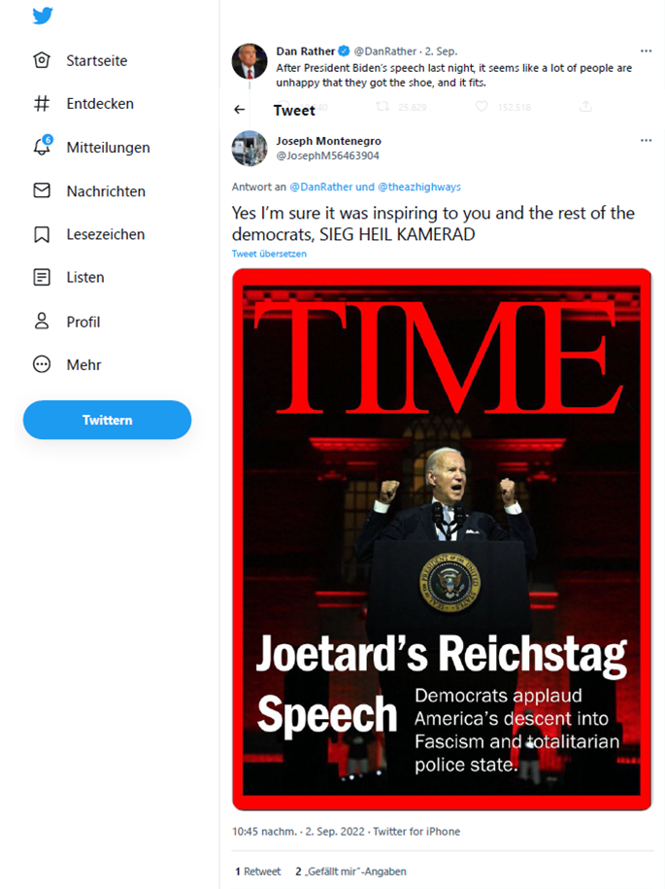

Slide 5
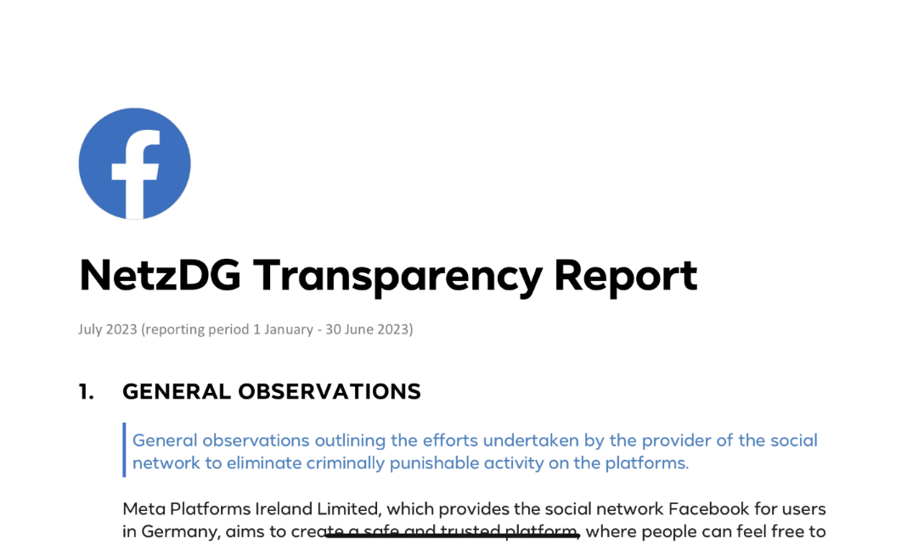

Slide 6
How we started regulating social networks
Challenge: Letter of accusation / fining notice must be duly delivered.
European Convention of 24 November 1977 on the Service Abroad of Documents relating to Administrative Matters.
Treaty on Mutual Legal Assistance in Criminal Matters (MLAT).

Slide 7
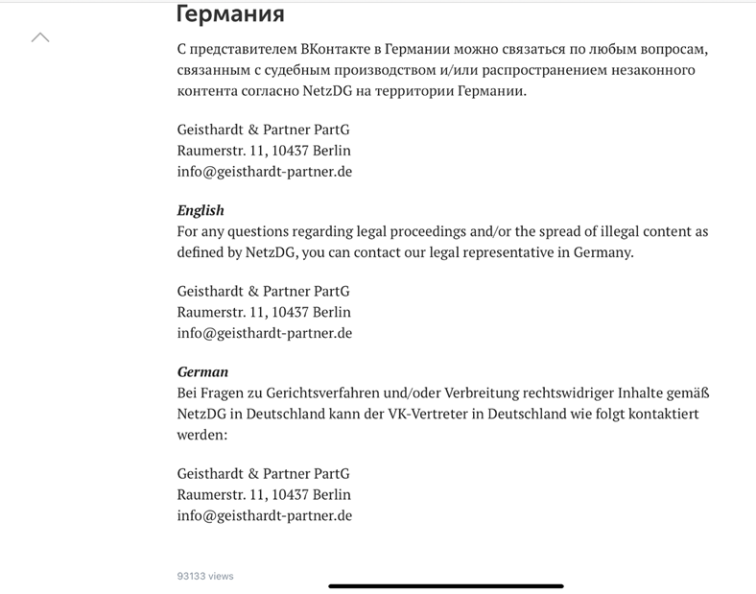

Slide 8
Regulatory Approach of the NetzDG
At the onset: Regulatory fines as the only enforcement tool.
Fine proceedings
aim to sanction misconduct that occured in the past.
are initiated either based on user reports or ex officio.
are higly formalized and typically lengthy based on experience.

Slide 9
Regulatory fines under the NetzDG
Regulatory fines can be as high as €50,000,000, depending e.g. on the network‘s number of registered users in Germany and the consequences of the violation.
The calculation of the fines is based on the Network Enforcement Act Regulatory Fining Guidelines (NetzDG-Bußgeldleitlinien), English language version available at: https://www.bundesjustizamt.de/SharedDocs/Downloads/DE/NetzDG/Leitlinien_Geldbussen_en.pdf?__blob=publicationFile&v=3

Slide 10
Regulatory fines under the NetzDG
Notable cases:
Telegram: €4,250,000 for the lack of reporting channels for unlawful content.
Telegram: €850,000 for the failure to name a legal representative with a summonable address in Germany.
Meta: €2,000,000 for the failure to publish a (complete) bi-annual transparency report with regard to Facebook)
Meta: €3,000,000 for the insufficient design of NetzDG reporting channels.
Various US-based operators: Fines ranging from €20,000 to €30,000).

Slide 12
Supervisory proceedings
Regulatory fines and supervision as complementary enforcement tools.
Supervisory proceedings:
address a deficiency in the present or in the future.
adapt to the circumstances of each individual case.
include an obligation for the provider to cooperate.
are fast, flexible and allow for a direct contact with the provider.
Tools: Order (to remedy a violation) and information requests.

Slide 13
Supervisory proceedings
Focus:
Enforcing the obligation to establish compliant reporting channels.

Slide 14
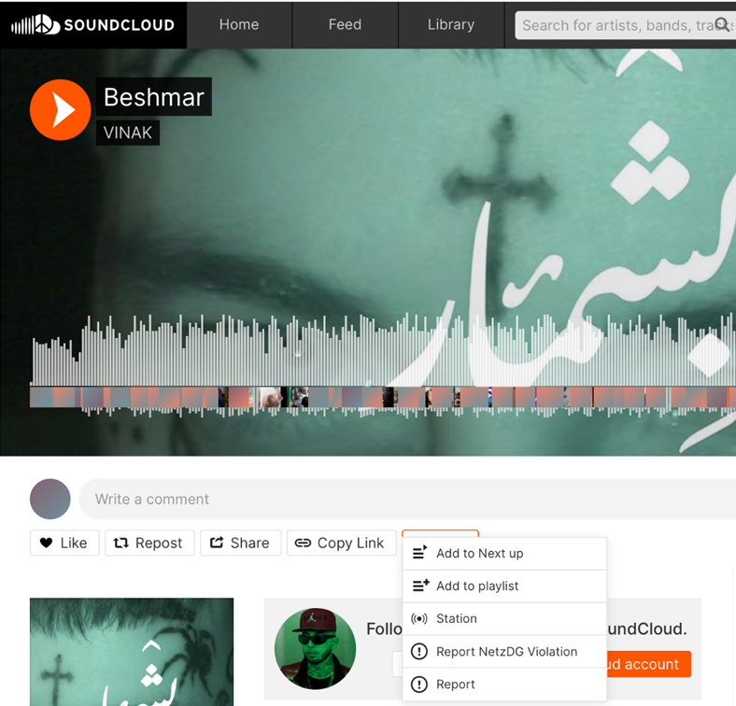
Case Study: SoundCloud

Slide 15
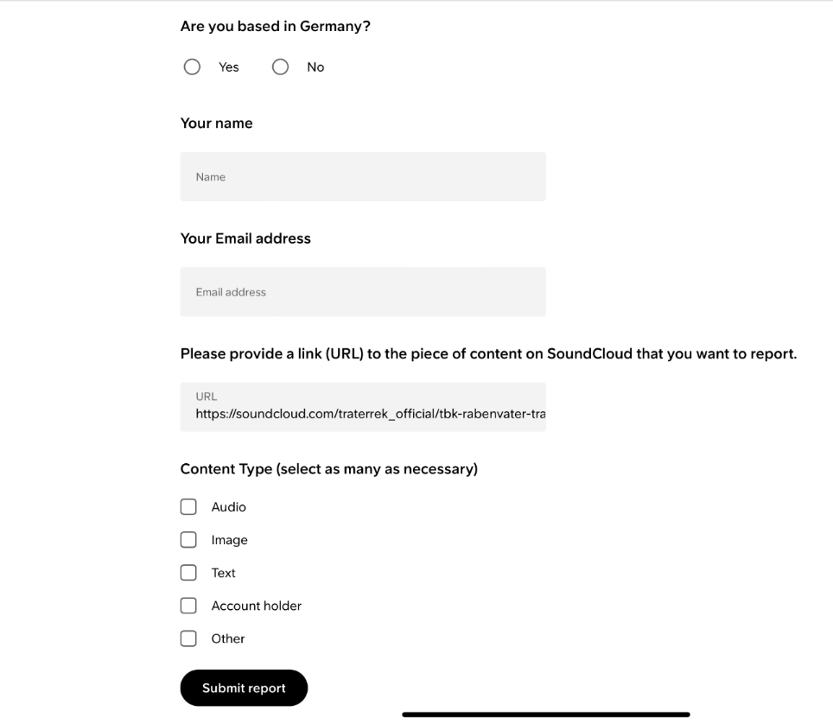

Slide 16
NetzDG Reporting Channels
High complexity of the supervisory proceedings with regard to reporting channels:
Integration of national reporting channels into international platform systems.
Different ways to access the platform: App versus browser, various devices (iPhone, Android phone…).
Different types of content: Posts, comments …
Different users (with / without a registration).
Frequent product launches.

Slide 17
Conclusions
Social networks must not constitute „legal outer space“: Efficient law enforcement requires continuity and consistency from stakeholders.
"Strength through Collaboration" – Preserving freedom of speech requires a holistic approach based on three pillars: Regulatory oversight by authorities, law enforcement, as well as victim protection measures and civil law enforcement.

Slide 18
Thank you for your attention!
Niels.Schulte@BfJ.Bund.de

