Slide 1


From rules to reality – International Comparative Approaches to Paid Political Advertising and Third-Party Campaigning
Magnus Ohman, Snr Political Finance Adviser, IFES

Slide 2
Outline
Paid political advertising in Europe
The European Union Regulation on Political Advertising
Provision of access to media for electoral contestants
Third party campaigning and influencers
Recommendations for North Macedonia
01
02
03
04
05

Slide 3

Recent developments in political advertising and media consumption
Political advertising, especially online has increased massively in the recent decade. Regulatory systems have struggled to keep up.
Campaigning by others than political parties and candidates is increasing: non-contestant campaigners (third parties) and influencers
People watch less and less live television, meaning that the provision of free airtime is becoming less meaningful for political parties and candidates

Slide 4
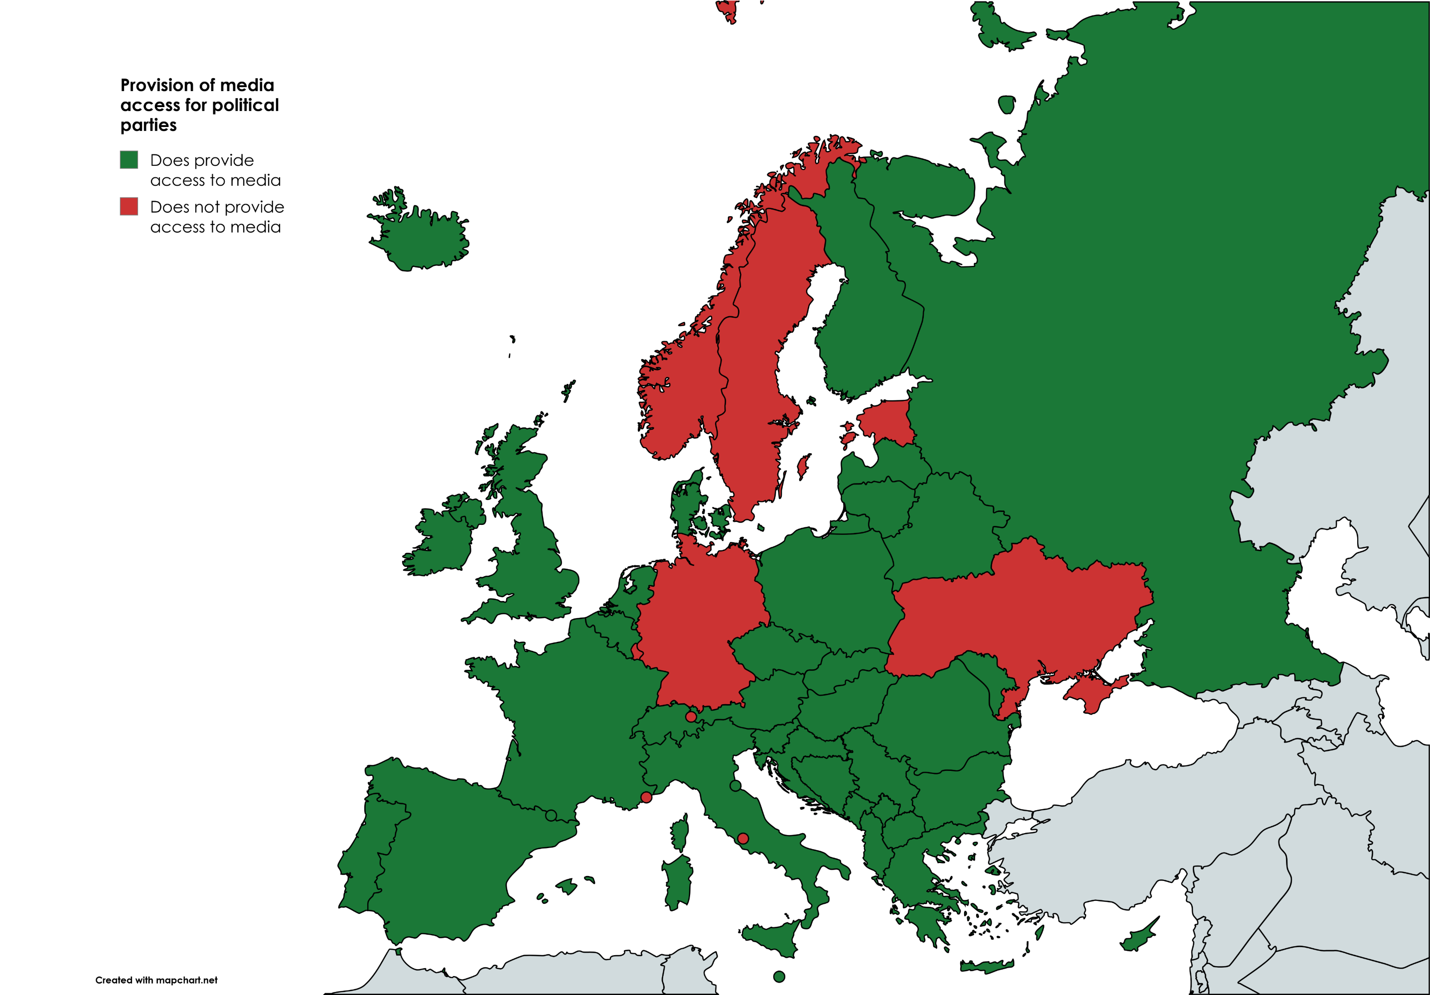
The European Union Regulation on Political Advertising
Provision of access to media for electoral contestants
Around 75% of European countries provide free media access
Some countries provide equal access to all parties (Bulgaria, Denmark, Slovakia)
Others allocate proportionally (Albania, Greece, Malta)
Some use a mix (Belgium, Spain)

Slide 5
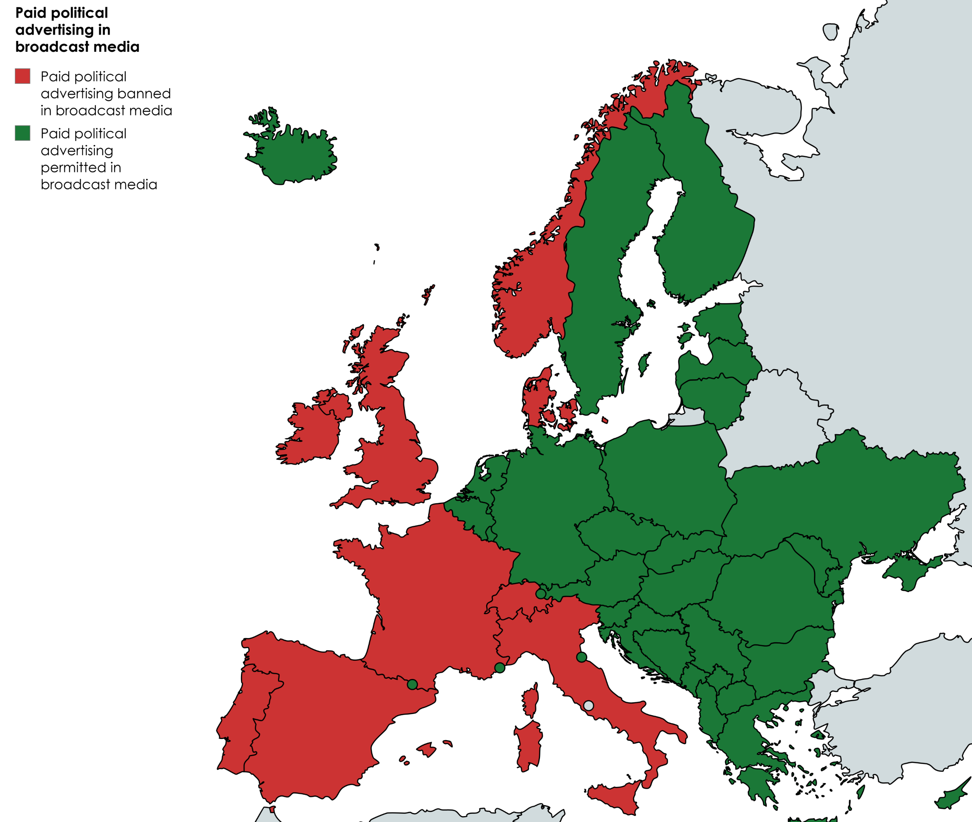
Bans on broadcast political advertising in European countries
Note: Apart from in France, these bans do not apply to political advertising online.

Slide 6
Rules on political advertising in European countries
Other examples: in Bosnia and Herzegovina, political advertising is banned in the period between the calling of an election and the start of the campaign. During campaigns, “public electronic media” must carry paid ads, max 30 mins/week
In Moldova, “audiovisual media services” must carry max 2 mins/day in paid ads
In Italy, political parties are not allowed to broadcast more than one message per day on the same broadcast unit.
The Czech Republic has no restrictions on political advertising, but does require imprints

Slide 7
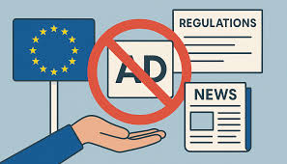
The European Union Regulation on Political Advertising
The European Union Regulation on Political Advertising
The European Union does normally not interfere with political finance rules in member states
New regulation came into force in October 2025. Provisions include:
Political adverts must be labelled (carry imprint) showing who paid and how much
Non-EU actors banned from advertising last three months before an election
Report advertising to national authorities and European Commission repository
European Commission to create repository of political adverts
As a response, Google, Meta and TikTok has banned political adverts in EU countries

Slide 8
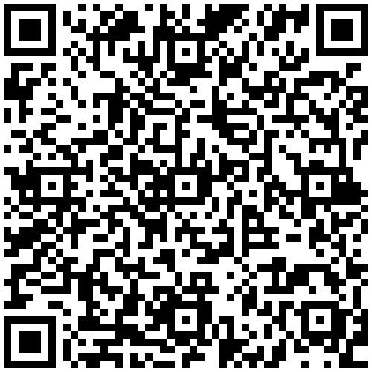
The European Union Regulation on Political Advertising
Non-contestant (third party) campaigning
Data is lacking due to a shortage of regulations, but indications are that non-contestant campaigning is increasing
Very few countries have regulations on non-contestant campaigning, often meaning that the information we have about their activities is very limited
Bans on political advertising often covers also non-contestants (cf. the UK), though note that these bans do not apply to online advertising (apart from in France)
See here for the UNCAC Resolution 11/7, which encourages countries to regulate non-contestant campaigning

Slide 9
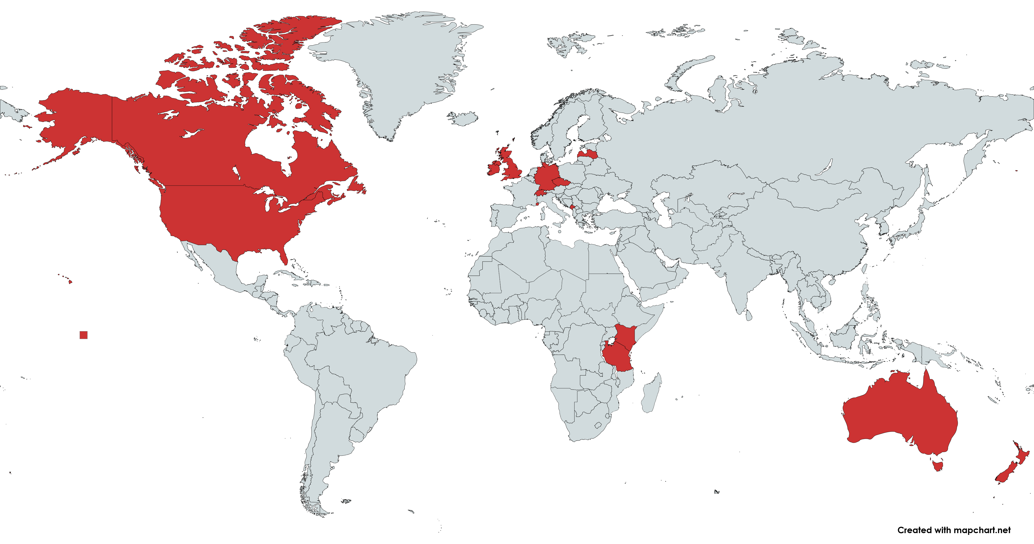
Where is non-contestant campaigning regulated?

Slide 10
What regulation exist?
 | Australia | Canada | Czech Rep. | Ireland | Latvia | Monaco | Montene. | New Zea. | Switz. | UK | US
Registration | Yes | Yes | Yes | Yes | No | No | No | Yes | No | Yes | Yes
Donor restrictions | Foreign | Foreign and anonymous | No | Foreign, anonymous (limits) | No | No | No | No | No | Same as for parties and candidates | Depends on the type of entity
Donation limit | No | No | No | No | No | No | Yes | No | No | No | Depends on type of entity
Spending limit | No | Yes | Yes | No | Yes | No | Yes | Yes | No | Yes | Depends on type of entity
Reporting | Yes | Yes | Yes | Not always detailed | No | Only if requested | Yes | Yes | Yes | Yes | Not always original donor
Advertising ban | No | No | No | No | No | No | No | No | No | Yes | No

Slide 11

The European Union Regulation on Political Advertising
The role of influencers
Becoming increasingly important in election campaigning.
No European countries have regulations specifically focused on influencers in elections, though other rules may have an impact.
Legally, influencers are NOT campaigners. They can take one or both of two roles:
Publishing paid advertising: Compare to online platform carrying political ads
Paid to participate in campaign: Compare to artist performing at rally

Slide 12
Recommendations for North Macedonia
Analyse media consumption and advertising experiences in North Macedonia to establish the current situation and likely future developments
Ensure that there is fair allocation of resources and media time for electoral contestants
Require imprints (labelling) of political advertising
Require those that run political adverts without running in elections (non-contestants) to follow rules similar to those for contestants (through dedicated law or Electoral Code)
Monitor paid political advertising, especially online, in collaboration with civil society
Clear institutional responsibilities in monitoring of online campaigns (and resources)
Developing a voluntary code of conduct for influencers
Raise awareness about political advertising among political parties and the population

Slide 13

Disclaimer:
This product was prepared within the Balkans Resilient Institutions for Democratic Governance and Elections (BRIDGE) project, funded by the UK Government with the support of the British Embassy Skopje, and the Electoral Support Programme of the Swiss Cooperation in North Macedonia, implemented by the International Foundation for Electoral Systems (IFES). The content of this product does not necessarily reflect the views of the donors, the projects, or the implementer(s).
QUESTIONS?

